Slide 1

A day with Cognitive Science Program
Faculty of Cognitive Sciences and Human Development

Slide 2

Presentation Checklists
CS Academic Staffs
CS Students
Bachelor of Science with Honours (Cognitive Science)
Future Career

Slide 3
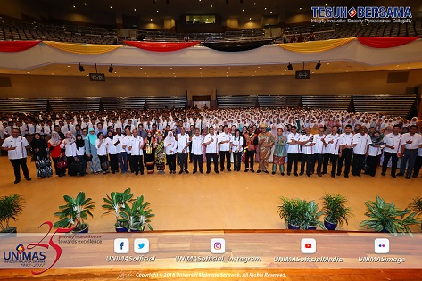
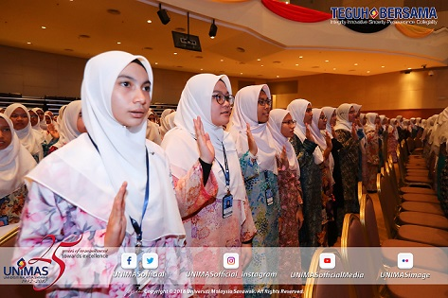
Welcome New CS Students
“Knowledge has always been important, of course. The ancient Egyptians did not raise the stones for the pyramids relying on the incantations of their gods. The waters in the irrigation canals of the great Indus Civilisation did not flow according to the laws of ignorance. Knowledge has always been power and wealth.”(Tun Mahathir)
3

Slide 4
Cognitive Science Academic Staffs

Slide 5
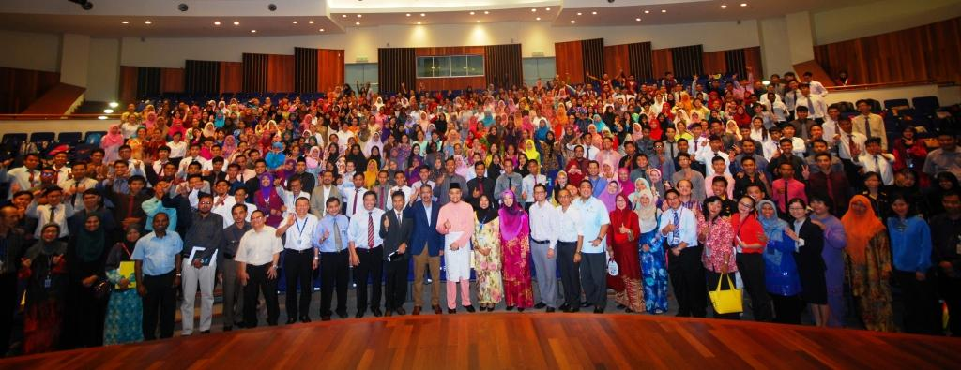
FCSHD Staffs
85 total staffs
HRD 22
Cognitive Science 24
Counselling 13
Psychology 9
Administration 17
http://www.fcshd.unimas.my/cognitive-sciences

Slide 6
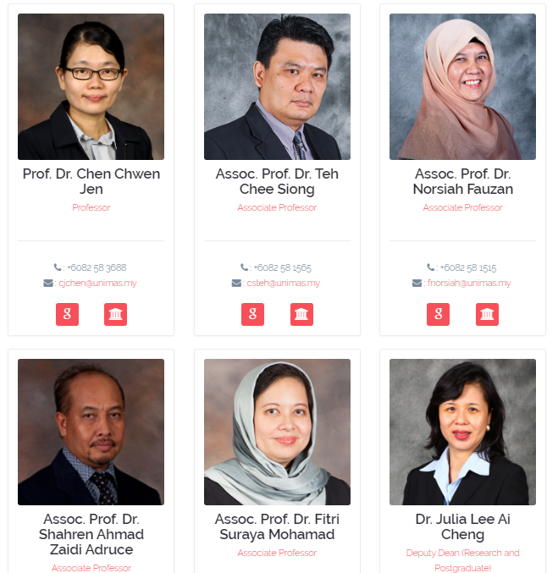
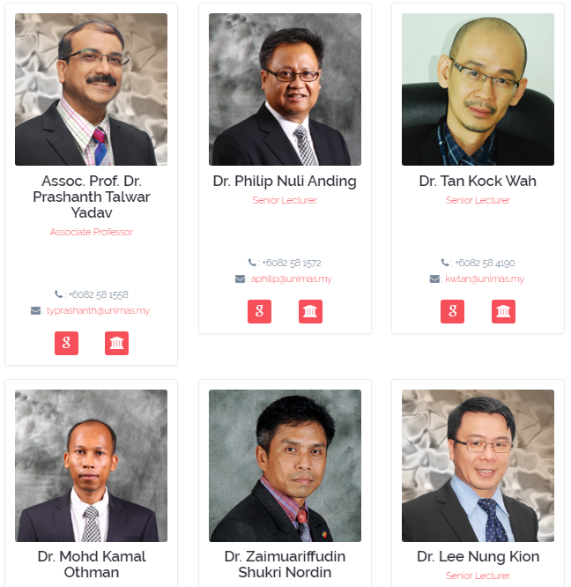

Slide 7
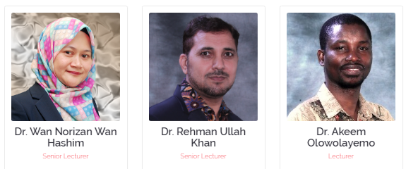
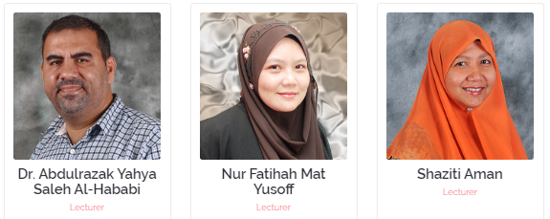
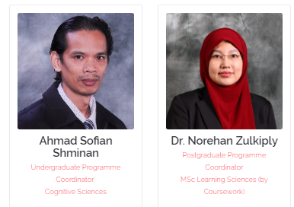
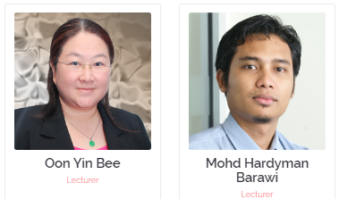
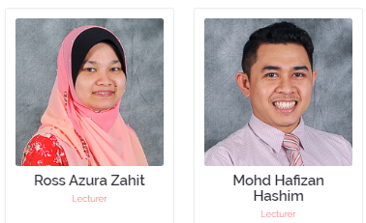

Slide 8
Cognitive Science Students

Slide 9
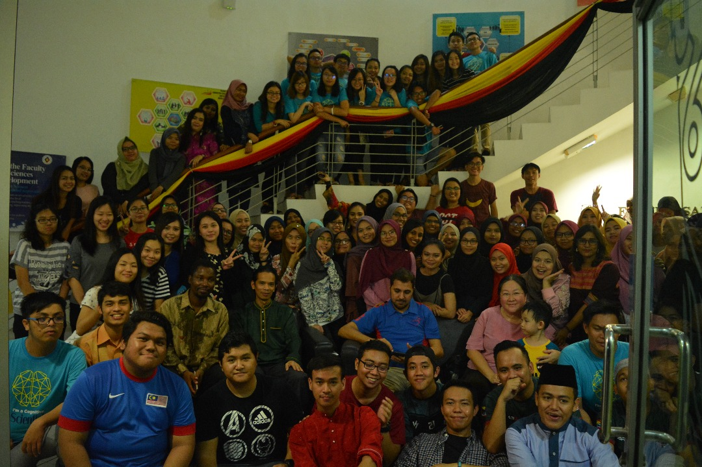
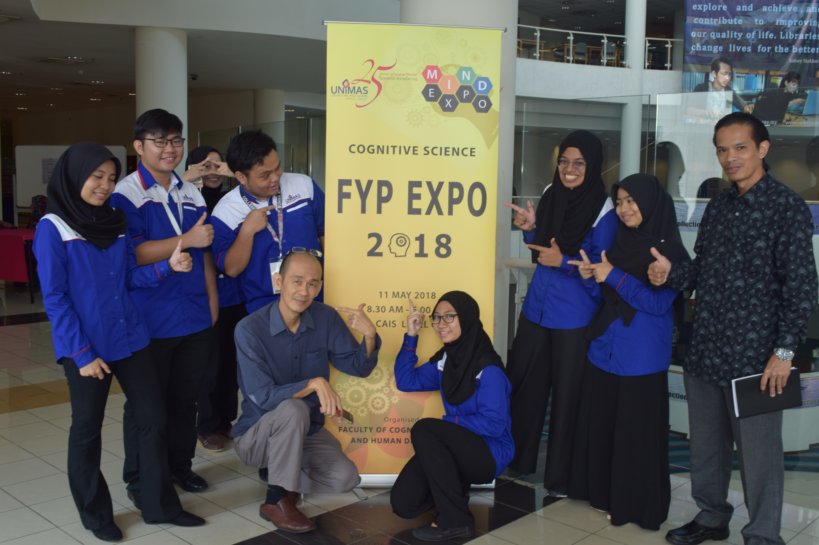
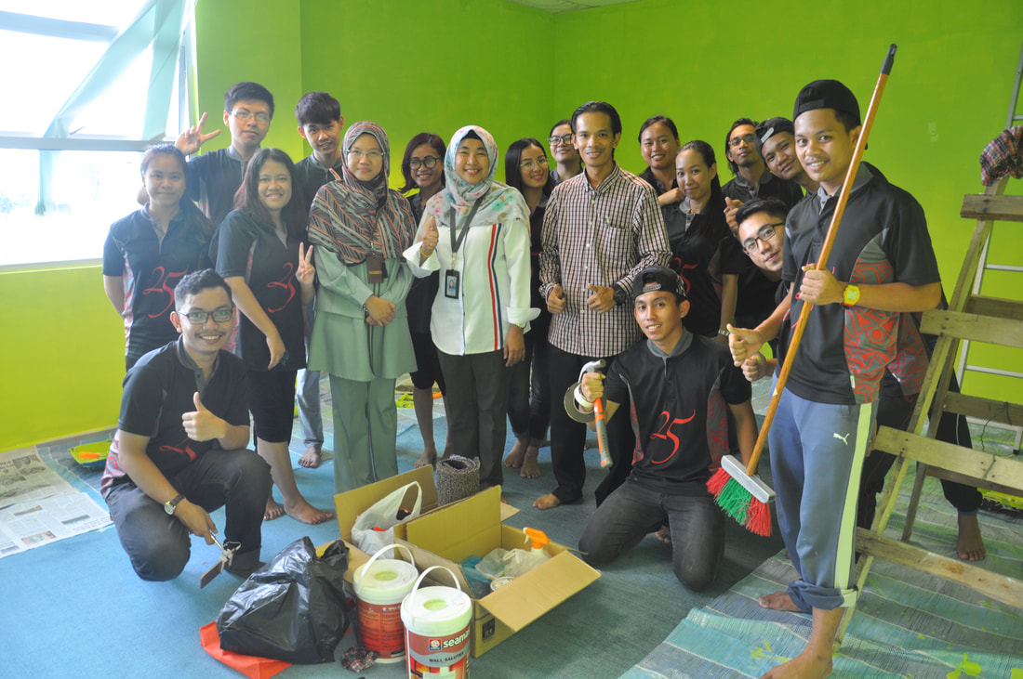

Slide 10
Bachelor of Science with Honours (Cognitive Science)

Slide 11
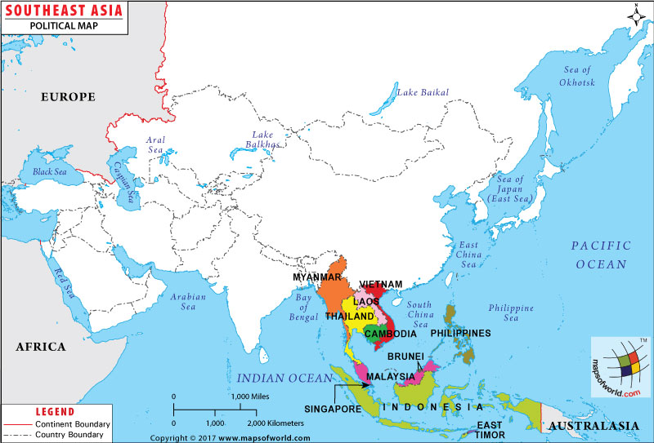
Bsc. (Cognitive Science) with honors.
First university in South East Asia to recognize the importance of the studies for understanding the mechanism of the mind
It draws from disciplines such as Psychology, Neuroscience, Linguistics, Artificial Intelligence and Philosophy with the central purpose of investigating the nature of mind and intelligence.

Slide 12
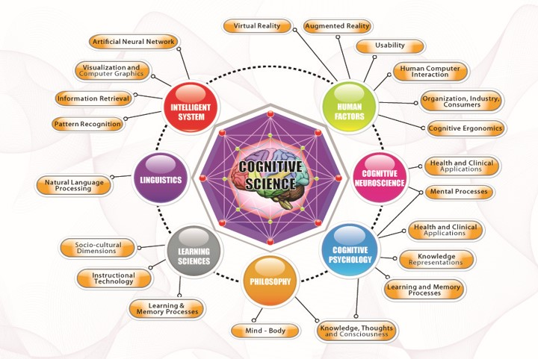

Slide 13
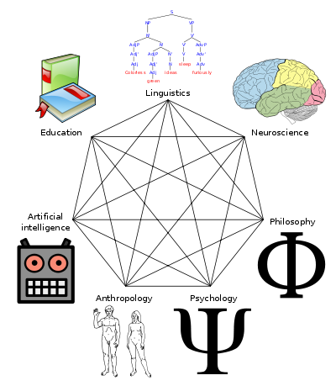
What is Cognitive Science?
Cognitive Science is an interdisciplinary study of mind and intelligence.
Cognitive Science combines various field, including;
Learning
Study of how people learn
Philosophy
Study of knowledge, reality and existence
Artificial Intelligence
Study of thinking machines and system
Cognitive Psychology
Study of behaviour and the mind
Cognitive Neuroscience
Study of nervous system
Linguistic
Study of language
Human Factors
study of how humans behave physically and psychologically in relation to particular environments, products, or services

Slide 14
Potential Future Career

Slide 15

Graduates from Cognitive Science programme could work as
Software designer and developer
Software, System or Web interface designer
System Analyst
Human Factor Personnel
Consumer Product Designer
Industrial Psychologist
Academician/Educator/Tutor
Instructional Designer
Researcher

Slide 16
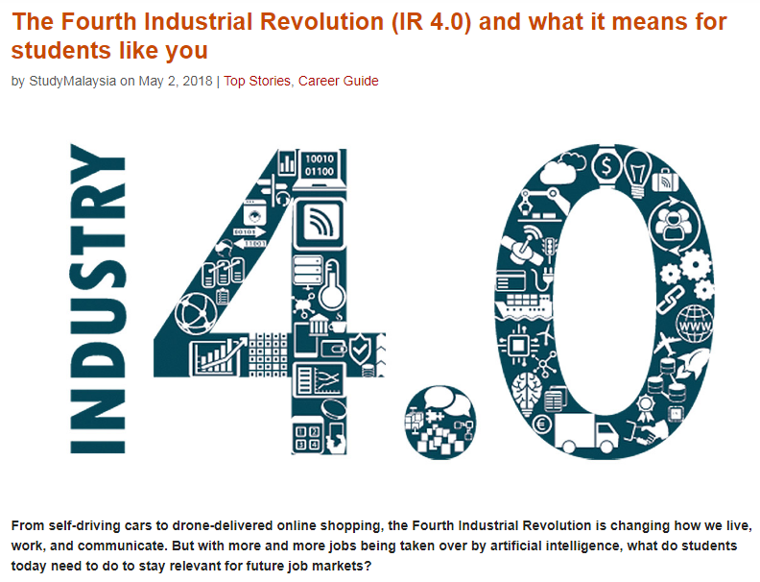
https://www.studymalaysia.com/education/top-stories/the-fourth-industrial-revolution-ir-4.0-and-what-it-means-for-students-like-you

Slide 17
Most Popular and high paid Jobs
Cognitive Developer
https://www.payscale.com/research/US/Job=Cognitive_Software_Engineer/Salary
Data Scientist
https://www.indeed.com/salaries/Data-Scientist-Salaries
machine learning Engineer
https://www.indeed.com/salaries/Machine-Learning-Engineer-Salaries

Slide 18
Cognitive Science Alumni

Slide 19
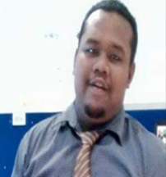
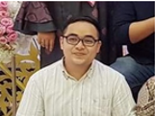

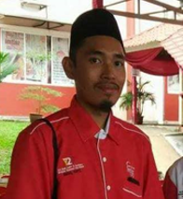
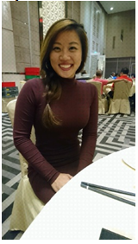





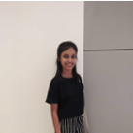

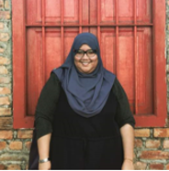


Who’s Who from the Cognitive Science Programme

Slide 20
Cognitive Science Entry Requirements

Slide 21
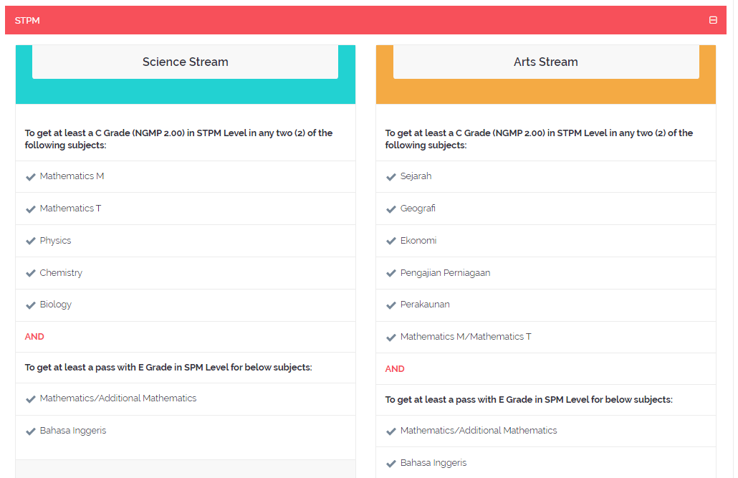
http://www.unimas.my/ws24-bachelor-of-science-with-honours-cognitive-science

Slide 22
Cognitive Science Academic Structure

Slide 23
Cognitive Science Academic Structure
Klasifikasi Kursus | Kredit
Kursus Teras (KT) Kursus Universiti (KU) Kursus Elektif (KE) | 66 26/30 30
Jumlah Keseluruhan Kredit | 122/126

Slide 24
Cognitive Science Academic Structure
Non Technical
KMK1133 Introduction to Linguistics Analysis
KMF1014 Introduction to Cognitive Science
KMF1023 Cognitive Psychology
KMK1313 Cognition and Design
KMF1043 Human Development Psychology
KMF1053 Cognitive Neuroscience
KMK1493 Cognition Tools for Learning
KMK2133 Philosophy of Mind
KMK2273 Cognition and Learning
KMF2024 Research Methodology
KMK2383 Narrative and Discourse Analysis
KMF3013 Human and Organisational Behavior
KMK3163 Project Management
KMK3513 Applied Neurosains for Special Needs
KMK3523 Learning Disabilities in An Inclusive Society
Technical
KMK1093 Basic Programming
KMK1103 Discrete Structure
KMK1143 Foundations of Artificial Intelligence
KMK1123 Calculus and Linear Algebra
KMK2313 Human Factors and Ergonomics
KMK2333 Expert Systems Analysis and Design
KMK2363 Instructional Technology Design and Development
KMK2533 Fundamentals of Data Mining
KMK2233 Artificial Neural Networks
KMK2213 Object Oriented Programming
KMK3503 Computational Thinking
KMK2263 Database Management Systems
KMK2473 Computer Graphics
KMK3323 Human Computer Interaction
KMK3393 Web Programming
KMK3113 Virtual Reality
KMK3483 Computer Vision
KMK3013 Knowledge-Based System
KMK3093 Computational Intelligence
KMK3053 Computational Linguistics
KMK3433 Mobile Computing

Slide 25
PENAWARAN KURSUS MENGIKUT TAHUN PENGAJIAN
Tahun 1 Semester 1
Kod Kursus | Nama Kursus | Kredit | Status | Prasyarat
KMK1093 | Asas Pengaturcaraan | 3 | KT | Tiada
KMK1103 | Struktur Diskret | 3 | KT | Tiada
KMK1133 | Pengantar Analisis Linguistik | 3 | KT | Tiada
KMF1014 | Pengenalan Sains Kognitif | 4 | KT | Tiada
KMF1023 | Psikologi Kognitif | 3 | KT | Tiada
MPU3122 | Tamadun Islam dan Tamadun Asia (TITAS) | 2 | KU | Tiada
PBI1112/ PBI1XXX | Persediaan Bahasa Inggeris I atau Pilihan Bahasa Inggeris I | 2 | KU | Rujuk m/s 30
PPD1041 | Kursus Kemahiran Insaniah dan Kesukarelawan | 1 | KU | Tiada
 | Jumlah Kredit | 19/21

Slide 26
Tahun 1 Semester 2
Kod Kursus | Nama Kursus | Kredit | Status | Prasyarat
KMK1143 | Asas Kepintaran Buatan | 3 | KT | Tiada
KMK1123 | Kalkulus dan Algebra Linear | 3 | KT | Tiada
KMK1313 | Kognisi dan Rekabentuk | 3 | KT | Tiada
KMF1043 | Psikologi Perkembangan Manusia | 3 | KT | Tiada
KMF1053 | Neurosains Kognitif | 3 | KT | Tiada
MPU3412 | Kompetensi ICT | 2 | KU | Tiada
MPU3222 | Asas Pembudayaan Keusahawanan | 2 | KU | Tiada
PBI1122/ PBI1XXX | Persediaan Bahasa Inggeris II atau Pilihan Bahasa Inggeris II | 2 | KU | Rujuk m/s 30
PPD1032 | Ko-Kurikulum Berkredit | 2 | KU | Tiada
 | Jumlah Kredit | 20/23
Tahun 2 Semester 1
Kod Kursus | Nama Kursus | Kredit | Status | Prasyarat
KMK2133 | Falsafah Minda | 3 | KT | Tiada
KMK2313 | Faktor Manusia dan Ergonomik | 3 | KT | Tiada
KMK2333 KMK1493 | Analisis dan Rekabentuk Sistem Pintar atau Alatan Kognitif untuk Pembelajaran | 3 | KE | Tiada
KMK2363 KMK2533 | Rekabentuk Pembangunan dan Teknologi Pembelajaran atau Pengenalan kepada Perlombongan Data | 3 | KE | Tiada
KMF2014 | Statistik | 4 | KT | Tiada
PBI1XXX | Pilihan Bahasa Inggeris I | 2 | KU | Rujuk m/s 30
 | Jumlah Kredit | 16/18

Slide 27
Tahun 2 Semester 2
Kod Kursus | Nama Kursus | Kredit | Status | Prasyarat
KMK2273 | Kognisi dan Pembelajaran | 3 | KT | Tiada
KMF2024 | Pengkaedahan Penyelidikan | 4 | KT | Tiada
KMK2233 KMK2383 | Rangkaian Neuro Buatan atau Inkuiri Naratif dan Analisis Wacana | 3 | KE | Tiada
KMK2213 KMK3503 | Pengaturcaraan Berorientasikan Objek atau Pemikiran Komputasi | 3 | KE | Tiada
KMK2263 KMK2473 | Sistem Pengurusan Pengkalan Data atau Grafik Komputer | 3 | KE | Tiada
MPU3112 | Hubungan Etnik | 2 | KU | Tiada
MPU3312 | Bahasa Melayu | 2 | KU | Tiada
PBI1XXX | Pilihan Bahasa Inggeris II | 2 | KU | Rujuk m/s 30
 | Jumlah Kredit | 20/22
Tahun 2 Antarsesi
Kod Kursus | Nama Kursus | Kredit | Status | Prasyarat
KMK2305 | Latihan Industri | 5 | KT | Tiada
 | Jumlah Kredit | 5

Slide 28
Tahun 3 Semester 1
Kod Kursus | Nama Kursus | Kredit | Status | Prasyarat
KMK3323 | Interaksi Manusia Komputer | 3 | KT | Tiada
KMK3103 | Projek Tahun Akhir 1 | 3 | KT | KMF2024
KMF3013 | Tingkahlaku Manusia dan Organisasi | 3 | KT | Tiada
KMK3393 KMK3113 | Pengaturcaraan Web atau Realiti Maya | 3 | KE | Tiada
KMK3483 KMK3163 | Visi Komputer atau Pengurusan Projek | 3 | KE | Tiada
 | Kursus Elektif Univeristi I | 3 | KE | Tiada
 | Jumlah Kredit | 18
Tahun 3 Semester 2
Kod Kursus | Nama Kursus | Kredit | Status | Prasyarat
KMK3104 | Projek Tahun Akhir II | 4 | KT | Tiada
KMK3093 KMK3513 | Kepintaran Berkomputer atau Neurosains Gunaan untuk Kanak-kanak Istimewa | 3 | KE | Tiada
KMK3053 KMK3523 | Komputasi Linguistik atau Masalah Pembelajaran dalam Masyarakat Inklusif | 3 | KE | Tiada
KMK3433 KMK3013 | Perkomputeran Mudah Alih atau Sistem Berasaskan Pengetahuan | 3 | KE | Tiada
 | Kursus Elektif Univeristi II | 3 | KU | Tiada
 | Kursus Elektif Univeristi III | 3 | KU | Tiada
 | Jumlah Kredit | 19

Slide 29


Slide 30
Who’s Who from the Cognitive Science Programme
Tan Tun Tai
Chong Shin Wee
Year of Graduation: 2009
Work as System Analyst in CSS MSC Sdn Bhd
Year of Graduation: 2014
Work at Duke-NUS Medical School, Singapore

Slide 31
Who’s Who from the Cognitive Science Programme
Sadia Afrin
Year of Graduation:
2018
Master of Computational Logic – Dresden University of Technology, Germany
Final Year Project: Ancient Kawi Script Recognition Using Deep Learning.
Intern: Data Solution Sdn. Bhd.
Foo Zhi Zhang
Year of Graduation: 2017
Web designer
Company: IT (web application and website)
Motivation:
you can lose interest right now, but don’t lose your dream for your future.

Slide 32
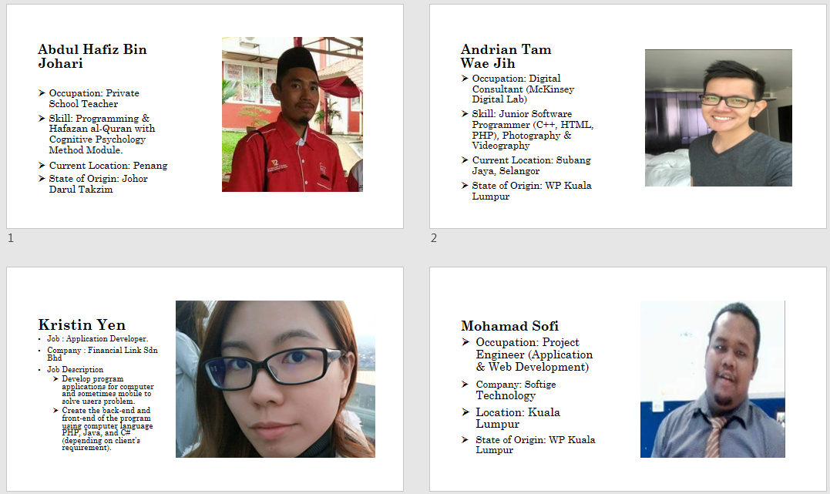

Slide 33
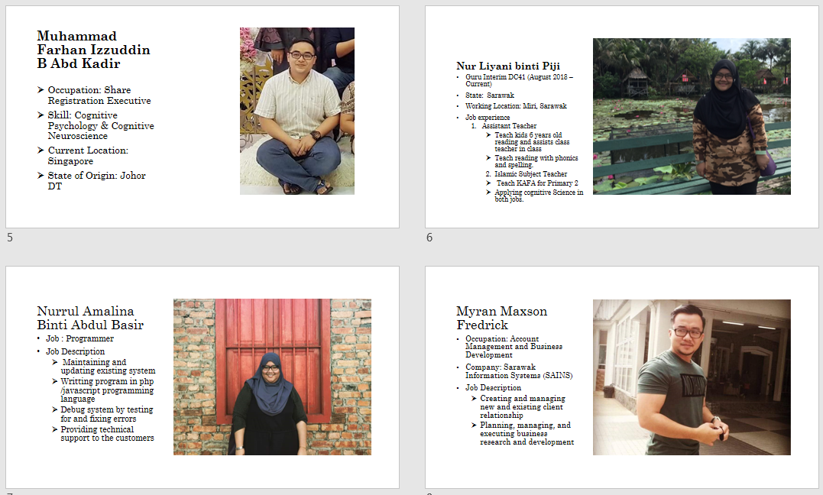

Slide 34
